Slide 1

Deconstructing Housing Prices using Regression Techniques
Application of Python and Machine Learning in predicting HDB resale prices in Singapore
G2T3
Neo Tee Yong | Sia Yan Rui (Jayden) | Tan Yan Sheng
Yieh Yuheng (Donovan) | Yohana Meiliana Lee

Slide 2

AGENDA
Recap
Methodologies
Results & Discussion
Conclusion
Future Work
References

Slide 3
Recap
Background
Motivation
88% of Singaporeans, especially millennials are unhappy
69% of millennials face difficulty funding their housing purchase as they are unable to gauge housing prices
Lack of Insight
Impacts Financial Planning
Timely & Costly
[1]
Problem Statement
As 80% of Singaporeans stay in HDB flats [2], using data mining techniques, we aim to find out what are the key features affecting HDB resale prices and use them to predict HDB resale prices with machine learning models.

Slide 4
Recap
Literature Review
All projects reviewed have applied EDA on the dataset before applying ML algorithms
Literature Title | ML Techniques | Dimensionality Reduction | Remarks
Predicting the prices of HDB flats in SG by Zhi Liang, Chen [3] | Random Forest | Correlation Matrix | Set variance threshold to 90%
 | Single Decision Tree | Variance Inflation Factor | Identified 7 features in order to reach 90% threshold
 | K-Nearest Neighbours |  | Used feature extraction to create additional features uncorrelated to each other in order to reach threshold
Comprehensive Data Exploration with Python by Pedro Marcelino [4] | No ML algorithm used |  | Main Goal: Find insights through basic EDA
 |  |  | Warns that drawing conclusion from bivariate analysis is dangerous (Simpson paradox)
Singapore Flat Price Predictor by Sie Huai, Gan [5] | ElasticNet |  | Used Ensemble learning method (Stacking) to combine 4 learners
 | SVM
 | Lasso Regression
 | Gradient Boosting
Table 1: Summary of Literature Review

Slide 5
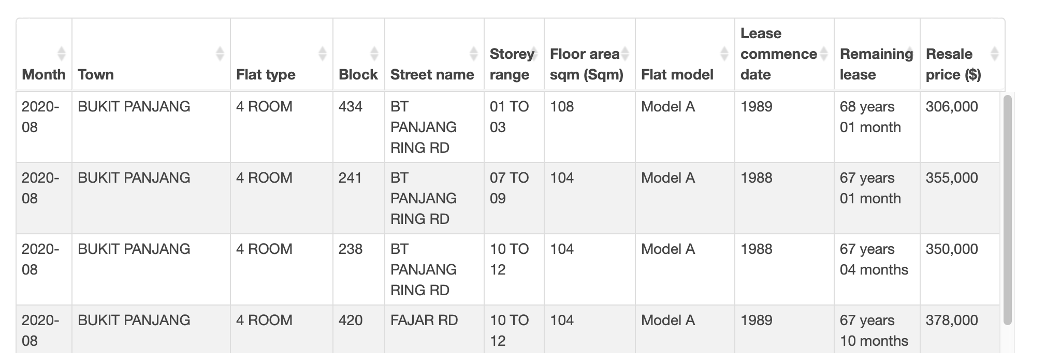
Recap
Data Set
Figure 1 : Dataset with different variables on Resale Flat Prices. From Jan 2015 onwards
Resale Flat Prices (Based on Registration Date), From Jan 2015 onwards
Taken from Data.Gov [6]
No. of Rows: 112,626
7 Nominal 1 Ordinal 0 Interval 2 Ratio

Slide 6
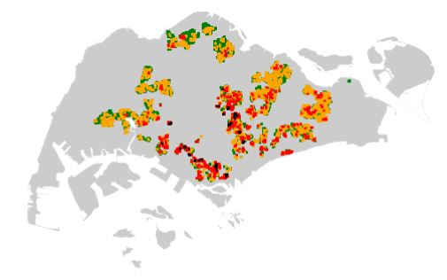

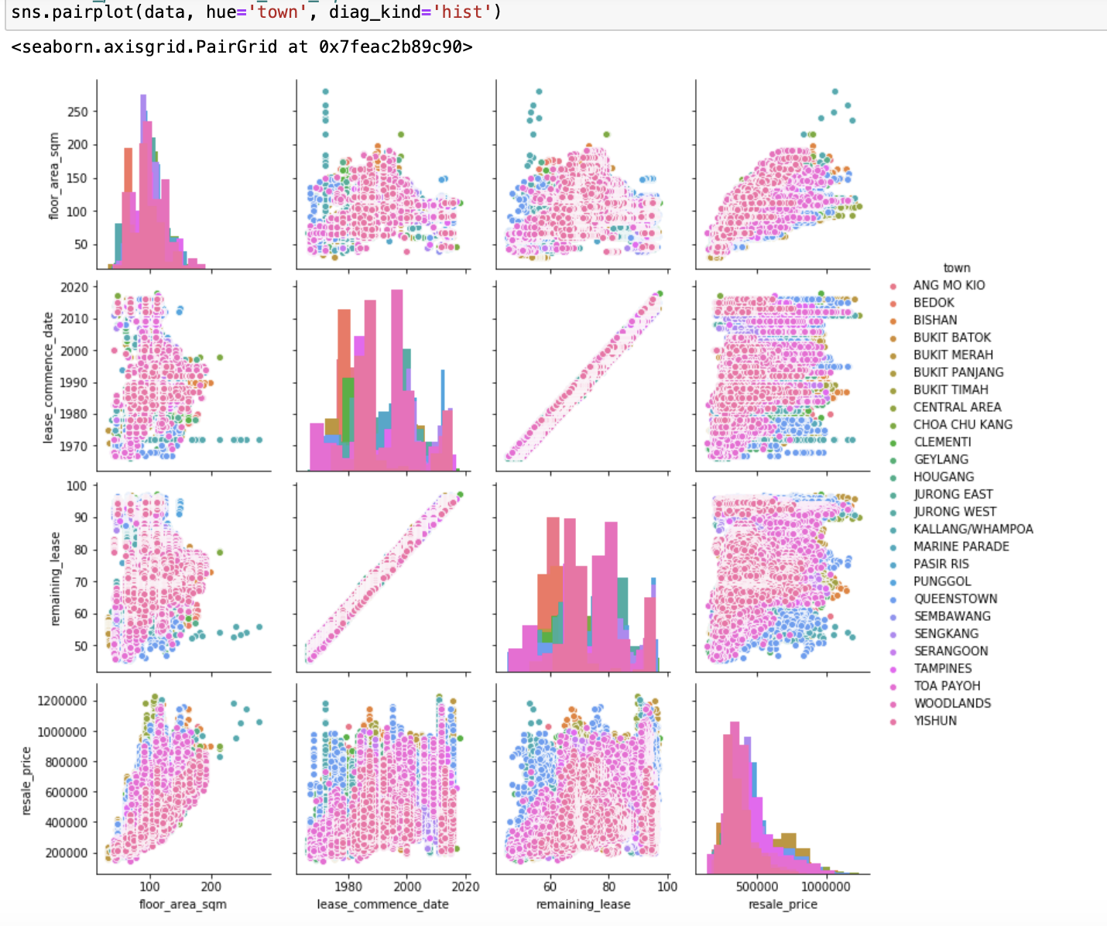
Recap
Exploratory Data Analysis
Visualizations
Missing values
Geographical visualization
Collinearity
Univariate analysis
Bivariate analysis
Data Pre-processing
Figure 2: Geographical Visualization
Data scaling & transformation
Encoding of categorical to numerical
Retrieval of latitude and longitude
Discretization (Encoding)
Figure 3: Pairplot Visualization

Slide 7
What we do
Our Guiding Principle
We aim to explore the breadth and depth of regression techniques, simultaneously capitalizing on local/ contextual knowledge to increase accuracy
Local Context
Retrieving of Latitude and Longitude
Nearest amenities (minimum distance from popular amenities)
Maturity of estates by town

Slide 8


Feature Engineering
What we did
Rationale
Methodologies
Feature
Engineering
Use OneMap API to retrieve Latitude and Longitude, and use that to retrieve distance to nearest amenities (Shopping Mall, MRT, School)
Based of HDB’s website, classify based on Town: the maturity of estates in that area
Missing values
Geographical visualization
Collinearity
Univariate analysis
Bivariate analysis
These amenities are top priorities as Singaporeans look at travelling time as a priority, and proximity to school effects chances of getting into a school [7]
Latitude & Longitude can be good features to predict housing price as they are on more granular level than zipcode.
Newer estates are more appealing to home-buyers in Singapore [8]
OneMap API
Selenium Webscraper
Pre-Processing
Modelling
Notes:
https://www.propertyguru.com.sg/property-management-news/2015/2/85301/the-mrt-effect-how-it-will-affect-your-propertys-value#:~:text=Distance%20to%20train%20station,those%20which%20are%20further%20away.
https://www.99.co/blog/singapore/mrt-stations-property-prices/
https://www.99.co/blog/singapore/distance-schools-property-address-house/
https://www.straitstimes.com/opinion/how-school-proximity-affects-house-prices-in-singapore

Slide 9
Pre-Processing
Methodologies
Rationale
Label Encoding
Dimensionality Reduction
Data Scaling
We converted categorical variables to numerical variables. For example converting Storey_Range to floor values
Drop columns that are high in multicollinearity and can be noise identified in EDA. No PCA.
Prevent inaccuracy of giving unnecessarily high weights to values with large range
Feature Engineering
Pre-Processing
Modelling
Notes:
We used Longitude and Latitude to get the min distance from the resale flats to Schools, MRT and Malls

Slide 10
Modelling
Methodologies
Rationale
Regression Models
Linear Regression
Lasso Regression w gradient descent
Ridge Regression w gradient descent
Elastic Net Regression w gradient descent
K-Neighbors Regression
Decision Tree Regression
Feature Engineering
Identify which Regression models gives the best evaluation metrics
Evaluate how the different models suit the “business” scenario
Pre-Processing
Ensemble Methods
Adaboost
XGBoost
RandomForest
G2T3Voting
G2T3Stacking
Modelling
Reduce MSE (with the risk of overfitting)
Evaluate differences between voting and stacking techniques
Table 2: Summary of all Data Mining Techniques Deployed
Notes:
https://www.propertyguru.com.sg/property-management-news/2015/2/85301/the-mrt-effect-how-it-will-affect-your-propertys-value#:~:text=Distance%20to%20train%20station,those%20which%20are%20further%20away.
https://www.99.co/blog/singapore/mrt-stations-property-prices/
https://www.99.co/blog/singapore/distance-schools-property-address-house/
https://www.straitstimes.com/opinion/how-school-proximity-affects-house-prices-in-singapore

Slide 11
Ranking of Models
Regression/Ensemble Models |  | MSE on test data | Ranking
Random Forest Ensemble |  | 0.03444 | 1
XGBoost Ensemble |  | 0.04382 | 2
K Neighbors Regression |  | 0.05991 | 3
Decision Tree Regression |  | 0.06351 | 4
Lasso Regression w gradient descent (alpha= 0.0001) |  | 0.2655 | 5
Linear Regression |  | 0.2655 | 6
Ridge Regression w gradient descent (alpha= 1e-06) |  | 0.2655 | 7
Adaboost Ensemble |  | 0.4369 | 8
ElasticNet Regression w gradient descent |  | 0.8914 | 9
Table 3: Performance Ranking of Data Mining Techniques Deployed
Notes:
Adaboost was rank 9 due to model being sensitive to noise data and is highly affected by outliers.As our data have very different variation due to different flat type and location. This model was not applicable to be used as prediction model.
Verbally explain what is alpha briefly

Slide 12
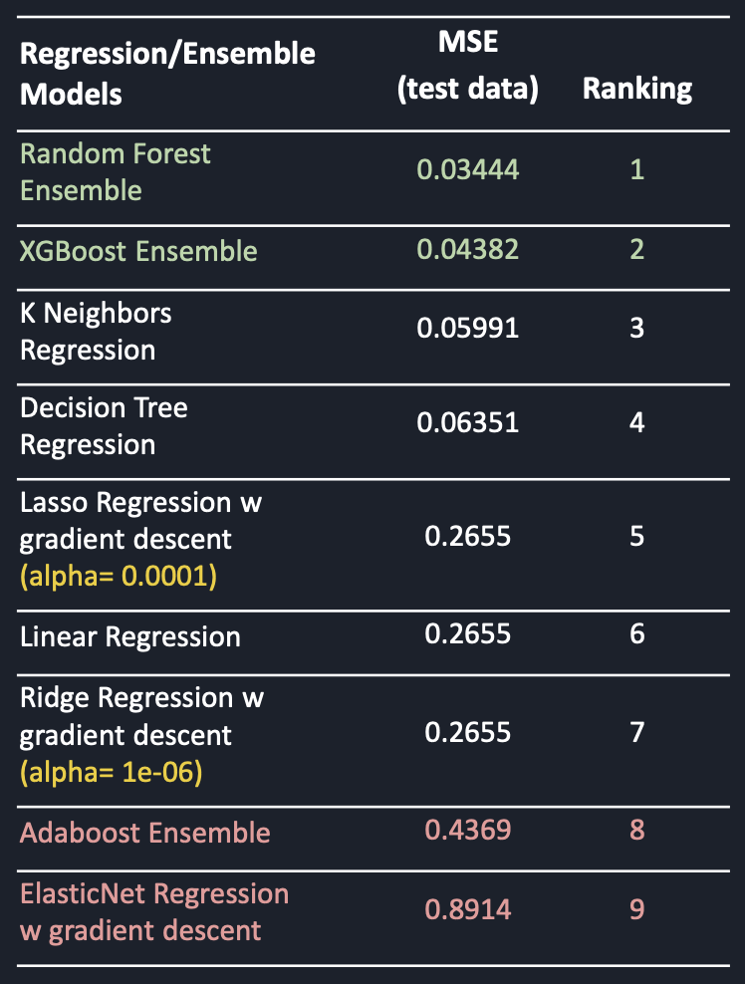
XGBoost Performance
Makes use of Gradient Boosting framework [9]
Reasons of it faring one of the best:
Divides data into multiple subsets and optimizes objective function for each subset [9]
Best used for structured, tabular dataset which is our dataset [10]
Utilized the concept of Regularization (Prevent overfitting) [11]
Table 4: Performance Ranking of XGBoost Ensemble
Notes:
https://xgboost.readthedocs.io/en/latest/
https://www.kdd.org/kdd2016/papers/files/rfp0697-chenAemb.pdf
https://towardsdatascience.com/https-medium-com-vishalmorde-xgboost-algorithm-long-she-may-rein-edd9f99be63d

Slide 13
Adaboost Performance
Combination of Bagging and Boosting [12]
Possible reasons of it faring the worse:
Overfitting
Our data has many different variations due to different flat type and locations, this may have led to increase “outliers” and led to a wider variation gap.
This model was very not applicable to be used as prediction model.
How we could improve the model:
Conduct cross-validation grid search for the n_estimator, base_estimator, learning rate [14]
Table 5: Performance Ranking of AdaBoost Ensemble
Notes:
https://quantdare.com/what-is-the-difference-between-bagging-and-boosting/
https://www.datacamp.com/community/tutorials/adaboost-classifier-python
https://machinelearningmastery.com/adaboost-ensemble-in-python/

Slide 14
ElasticNet w gradient descent Performance
Combination of Lasso and Ridge Regression
Possible reasons of it faring the worse:
Default alpha(a) = 1
Did not cross-validate the relative weight of L1 vs L2 penalty, alpha(a)
l1_ratio represents an even mixture of L1 and L2 penalties and does not fit the data well
How we could improve the model:
Conduct cross-validation grid search for the optimal value of alpha(a) [16]
[15]
Table 6: Performance Ranking of ElasticNet Regression
Notes:
https://www.tutorialspoint.com/scikit_learn/scikit_learn_elastic_net.htm
https://scikit-learn.org/stable/modules/generated/sklearn.linear_model.ElasticNetCV.html

Slide 15

Ranking of Models (with G2T3)
Regression/Ensemble Models | MSE | Ranking
Random Forest Ensemble | 0.03444 | 1
G2T3Stacking Ensemble | 0.03533 | 2
G2T3Voting Ensemble | 0.03617 | 3
XGBoost Ensemble | 0.04382 | 4
K Neighbors Regression | 0.05991 | 5
Decision Tree Regression | 0.06351 | 6
Lasso Regression w gradient descent | 0.2655 | 7
Linear Regression | 0.2655 | 8
Ridge Regression w gradient descent | 0.2655 | 9
Adaboost Ensemble | 0.4369 | 10
Elasticnet Regression w gradient descent | 0.8914 | 11
Table 7: Performance Ranking of Data Mining Techniques with G2T3’s Techniques Creation Deployed

Slide 16
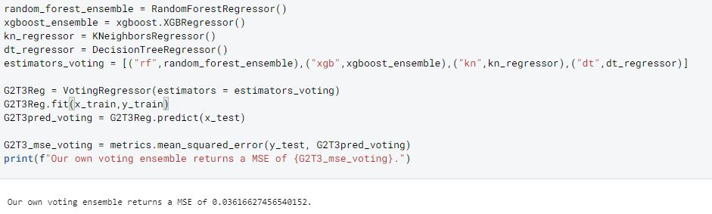
G2T3Voting
What this does? | Fits several base regressors, each on the whole dataset (x_train), and averages its individual prediction [17]
What this means? | This means that the accuracy metrics (Mean Squared Error) is dependent on the accuracy of its base regressors.
What we did | We selected 4 of our best performing models, with a criteria of MSE<0.1
Figure 4: Code Snippet of G2T3Voting in Python
Notes:
https://scikit-learn.org/stable/modules/generated/sklearn.ensemble.VotingRegressor.html

Slide 17
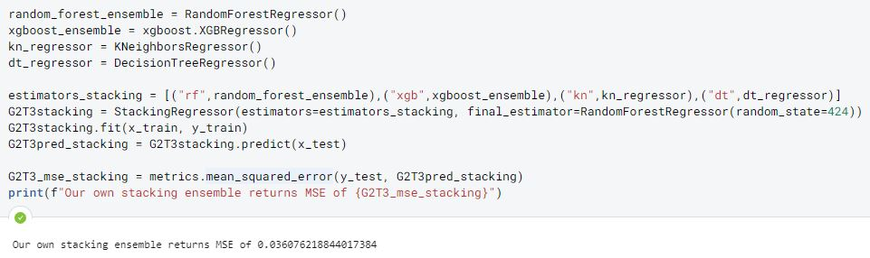
G2T3Stacking
What this does? | Stack base estimators Final estimator trained using cross-validated predictions of the base estimators [18]
What this means? | This means that the accuracy metrics (Mean Squared Error) is dependent on the accuracy of its base regressors. Cross validation is used (default Kfold=5)→ reduce overfitting
What we did | We selected 4 of our best performing models, with a criteria of MSE<0.1
Figure 5: Code Snippet of G2T3Stacking in Python
Notes:
https://scikit-learn.org/stable/modules/generated/sklearn.ensemble.StackingRegressor.html

Slide 18

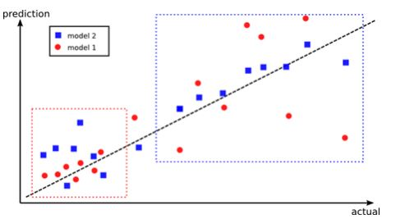
Voting vs Stacking
BIG QUESTION
Given similar conditions, why does stacking outperform voting?
Stacking
Split training data into K-folds
For each base model:
Base model is fitted on unique K-1 parts and then tested on the remaining K part.
Do 2a for all parts of training data
Fit base model on whole train data to calculate performance on test set
Predictions from test set is trained by the meta-model
How it works [20]
Figure 6: Stacking can improve prediction models [19]
Basically...
As the graph shows, stacking selectively combines the models where it performs best, whereas voting just aggregates them
Notes:
Graph: https://www.kdnuggets.com/2017/02/stacking-models-imropved-predictions.html
Steps: https://www.geeksforgeeks.org/stacking-in-machine-learning/
Solving a big problem by with different models capgrable to solve some parts of the problem

Slide 19
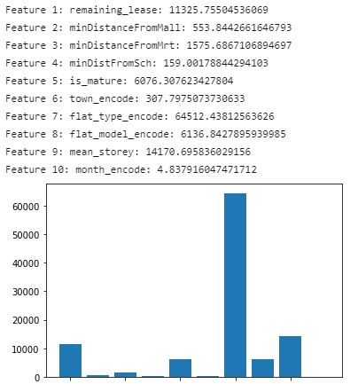
Feature Selection
Pearson’s Correlation Coefficient
Feature Selection
feature_selection.SelectKBest -> Selects features according to k highest scores.
k=”all” : Select all features
fs_model.score_ = to get score of all features
Score function = f_regression
Optimization
Next slide:
What is f_regression
How we select features
Results & Discussion
Conclusion
Figure 7: Feature Importance Based on K-Scores

Slide 20
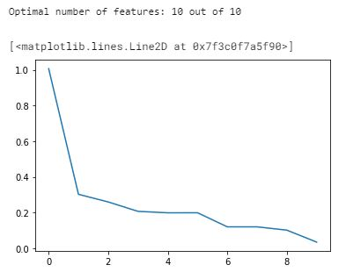
Feature Selection
Pearson’s Correlation Coefficient
f_regression
Tests the individual effect of each independent variable (x) to the dependent variable
Feature Selection
Greedy selection of features
Sorted features according to their scores (descending)
Run ensemble on top n features and measure mse on n features
Optimization
Dataset Used
All features are signals
Results & Discussion
Conclusion
Figure 8: Features (X) based on MSE(Y)

Slide 21
Optimization
Problem we faced when trying to optimise hyperparameters
We have a lot of training data (~110k rows)
Running GridSearchCV or RandomizedSearchCV to find the hyperparameters with the lowest MSE takes a long time
We did not have access to premium cloud computing tools (eg. AWS) to run our models
Some of our models for hyperparameters took days to run
Solution: we used stratified sampling to get a representative sample of the dataset, and used that for our hyperparameter optimisation instead.
Feature Selection
Optimization
Results & Discussion
Conclusion
Notes:
https://towardsdatascience.com/hyperparameter-tuning-the-random-forest-in-python-using-scikit-learn-28d2aa77dd74

Slide 22
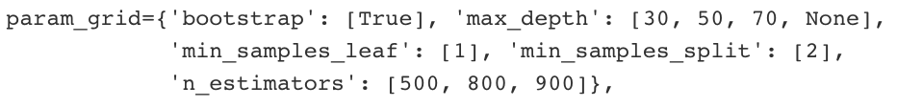
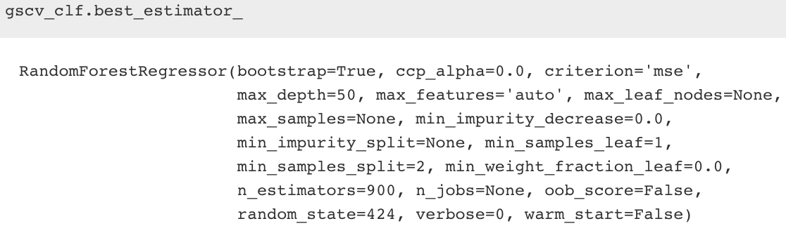
Optimization
Hyperparameter Tuning with GridSearchCV()
Grid search of parameters, with 5 fold cross validation
Fit 60 different combination of hyperparameters (5 folds x 12 candidates)
Param_grid:
Feature Selection
Optimization
Figure 9: GridSearchCV() hyperparameters
Results:
MSE: 0.03422
Results & Discussion
Figure 10: GridSearchCV() results
Conclusion
Notes:
https://towardsdatascience.com/hyperparameter-tuning-the-random-forest-in-python-using-scikit-learn-28d2aa77dd74

Slide 23
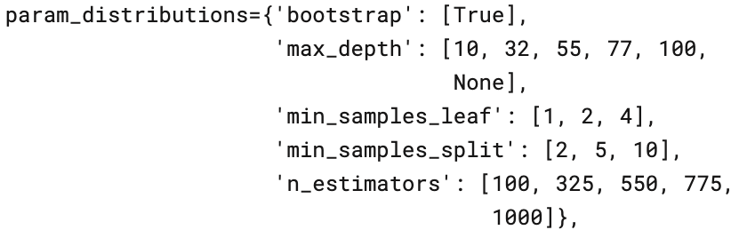
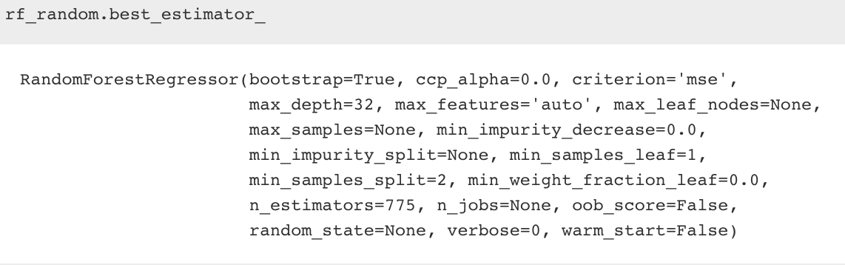
Optimization
Hyperparameter Tuning with RandomizedSearchCV()
Random search of parameters, with 5 fold cross validation
Fit 50 different combination of hyperparameters (5 folds x 10 candidates)
Param_distibutions:
Feature Selection
Optimization
Figure 11: RandomizedSearchCV() hyperparameters
Results & Discussion
Results:
MSE: 0.03418
Conclusion
Figure 12: RandomizedSearchCV() results
Notes:
https://towardsdatascience.com/hyperparameter-tuning-the-random-forest-in-python-using-scikit-learn-28d2aa77dd74

Slide 24
Results & Discussion
Our Value Proposition
Increase accuracy with local context
Breadth of Machine Learning models explored to identify optimal model
Depth of model → Optimization
Low MSE → Low cost passed to consumers
Feature Selection
Optimization
Results &
Discussion
Optimised MSE = 0.03418
Optimised Mean Absolute Error = 0.1310
Non-optimised MSE - Optimised MSE = 0.03444 - 0.03418 = 0.00026
Conclusion
Notes:
https://towardsdatascience.com/hyperparameter-tuning-the-random-forest-in-python-using-scikit-learn-28d2aa77dd74
437852.7906088291
1.9410252702911635e-06

Slide 25
Results & Discussion
Descriptive Analytics
Features | Coefficients
remaining_lease | 0.15081107
minDistanceFromMall | 0.02581348
minDistanceFromMrt | 0.03753714
minDistFromSch | 0.01509489
is_mature | 0.17689251
town_encode | 0.06770936
flat_type_encode | 0.45263233
flat_model_encode | 0.02603026
mean_storey | 0.03274444
month_encode | 0.01473452
Feature Selection
Coefficient of features in optimized model captures accurate weights of each feature related to housing price
Describes the nature of the problem to the users to provide greater insight
Optimization
Results &
Discussion
Conclusion
Table 8: Features and Coefficient
Notes:
https://towardsdatascience.com/hyperparameter-tuning-the-random-forest-in-python-using-scikit-learn-28d2aa77dd74
437852.7906088291

Slide 26
Results & Discussion
Predictive Analytics...
Feature Selection
Solves the problem by allowing users to accurately estimate housing price, granting ability for proper financial planning
Explored the breadth of regression models with tuning and optimisation to effectively predict resale price
Optimization
Results &
Discussion
… Effectively Targeting Problem Statement
As 80% of Singaporeans stay in HDB flats, using data mining techniques, we aim to find out what are the key features affecting HDB resale prices and use them to predict HDB resale prices with machine learning models.
Conclusion
Notes:
https://towardsdatascience.com/hyperparameter-tuning-the-random-forest-in-python-using-scikit-learn-28d2aa77dd74
437852.7906088291

Slide 27
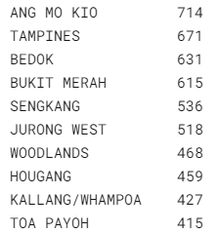
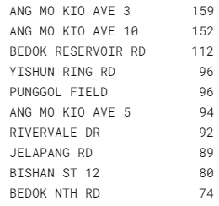
Results & Discussion
Prescriptive Analytics
Feature Selection
Grants users better insight to which areas in Singapore are undervalued/ likely to be undervalued
This allows Singaporeans to make more informed fiscal choices in the future when planning to buy houses
Optimization
Undervalued by Town
Undervalued by Street Name
Results &
Discussion
Conclusion
Figure 13: Top 10 Undervalued Town
Figure 14: Top 10 Undervalues Streets
Notes:
https://towardsdatascience.com/hyperparameter-tuning-the-random-forest-in-python-using-scikit-learn-28d2aa77dd74
437852.7906088291

Slide 28


Conclusion
Best algorithm: Optimized Random Forest
Relationship between latitude/longitude and housing price is not linear, so linear models might not work very well, but tree based models will work better in this case
They are based on trees, hence, scaling of the variables does not matter. Any monotonic transformation of a single variable is implicitly captured by a tree.
They use the random subspace method and bagging to reduce bias and prevent overfitting.
Feature Selection
Optimization
Results & Discussion
Problem Statement: Tackled
Conclusion
Through our paradigm of descriptive, predictive and prescriptive analytics

Slide 29



Future Work
Increased Features
Parameter Tuning
Accessibility of Information
For our Models, we would take into account other important factors such as inflation rate and government regulations on housing to make our price predictions more accurate.
Initial models are not optimized due to lack of computational power and time. This is costly as inaccuracy results in cost passed on to the consumers.
Findings can be shared with the public, and models deployed to enable them to make better decisions.

Slide 30
Reference
[1] R. Navaratnarajah, “88% Of Singaporeans Unhappy Over High Property Prices: PropertyGuru,” 3 8 2018. [Online]. Available: https://www.propertyguru.com.sg/property-management-news/2018/8/173701/88-of-singaporeans-unhappy-over-high-property-prices-propertyguru. [Accessed 28 9 2020].
[2] J. Muller, “Population living in public housing in Singapore 2010-2018 Published by J. Müller, Jan 14, 2020 This statistic shows the share of the resident population in Singapore living in public housing under the Housing and Development Board (HDB), from 2010 to 20,” 14 1 2020. [Online]. Available: https://www.statista.com/statistics/966747/population-living-in-public-housing-singapore/. [Accessed 28 9 2020].
[3] C. Z. Liang, “Predicting the prices of HDB flats in SG,” [Online]. Available: https://www.kaggle.com/chenzhiliang/predicting-the-prices-of-hdb-flats-in-sg . [Accessed 27 9 2020].
[4] P. Marcelino, “Comprehensive data exploration with Python,” 2 2017. [Online]. Available: https://www.kaggle.com/pmarcelino/comprehensive-data-exploration-with-python. [Accessed 27 9 2020].
[5] S. H. Gan, “Singapore Flat Price Predictor,” 3 6 2019. [Online]. Available: https://towardsdatascience.com/singapore-flat-price-predictor-6f74ed8da311. [Accessed 28 9 2020].
[6] Housing and Development Board, “Resale Flat Prices,” [Online]. Available: https://data.gov.sg/dataset/resale-flat-prices. [Accessed 29 9 2020].

Slide 31
Reference
[7] R. Navaratnarajah, “The MRT Effect: How It Will Affect Your Property's Value,” 25 2 2015. [Online]. Available: https://www.propertyguru.com.sg/property-management-news/2015/2/85301/the-mrt-effect-how-it-will-affect-your-propertys-value#:~:text=Distance%20to%20train%20station,those%20which%20are%20further%20away.. [Accessed 4 11 2020].
[8] J. T. A. LIN, “Make new towns more appealing to home buyers Read more at https://www.todayonline.com/voices/make-new-towns-more-appealing-home-buyers,” 22 6 2014. [Online]. Available: https://www.todayonline.com/voices/make-new-towns-more-appealing-home-buyers. [Accessed 4 11 2020].
[9] ReadTheDocs, “XGBoost Documentation,” 2020. [Online]. Available: https://xgboost.readthedocs.io/en/latest/. [Accessed 4 11 2020].
[10] T. Chen, “XGBoost: A Scalable Tree Boosting System,” 2016. [Online]. Available: https://www.kdd.org/kdd2016/papers/files/rfp0697-chenAemb.pdf. [Accessed 4 11 2020].
[11] V. Morde, 4 8 2019. [Online]. Available: https://towardsdatascience.com/https-medium-com-vishalmorde-xgboost-algorithm-long-she-may-rein-edd9f99be63d. [Accessed 4 11 2020].
[12] apporas, “What is the difference between Bagging and Boosting?,” 20 4 2016. [Online]. Available: https://quantdare.com/what-is-the-difference-between-bagging-and-boosting/. [Accessed 4 11 2020].

Slide 32
Reference
[13] A. Navlani, “AdaBoost Classifier in Python,” 21 11 2018. [Online]. Available: https://www.datacamp.com/community/tutorials/adaboost-classifier-python. [Accessed 4 11 2020].
[14] J. Brownle, “How to Develop an AdaBoost Ensemble in Python,” 13 8 2020. [Online]. Available: https://machinelearningmastery.com/adaboost-ensemble-in-python/. [Accessed 4 11 2020].
[15] Scikit Learn, “Scikit Learn - Elastic-Net,” 5 5 2020. [Online]. Available: https://www.tutorialspoint.com/scikit_learn/scikit_learn_elastic_net.htm. [Accessed 4 11 2020].
[16] Scikit Learn, “sklearn.linear_model.ElasticNetCV,” 5 5 2020. [Online]. Available: https://scikit-learn.org/stable/modules/generated/sklearn.linear_model.ElasticNetCV.html. [Accessed 4 11 2020].
[17] Scikit Learn, “sklearn.ensemble.VotingRegressor,” 11 5 2020. [Online]. Available: https://scikit-learn.org/stable/modules/generated/sklearn.ensemble.VotingRegressor.html. [Accessed 4 11 2020].
[18] Scikit Learn, “sklearn.ensemble.StackingRegressor,” 11 5 2020. [Online]. Available: https://scikit-learn.org/stable/modules/generated/sklearn.ensemble.StackingRegressor.html. [Accessed 4 11 2020].
[19] U. S. B. Burak Himmetoglu, “Stacking Models for Improved Predictions,” 2 2017. [Online]. Available: https://www.kdnuggets.com/2017/02/stacking-models-imropved-predictions.html. [Accessed 4 11 2020].
[20] GeeksforGeeks, “Stacking in Machine Learning,” 20 5 2019. [Online]. Available: https://www.geeksforgeeks.org/stacking-in-machine-learning/. [Accessed 4 11 2020].

Slide 33
Thank you
Q&A

